Slide 1

Trending AI Job Data in 2025
Garima Agrawal
2025/11/13

Slide 2



01
Dataset Overview
02
Data Cleaning
03
Feature Engineering
04
Quality Assurance
05
Exploratory Insights

Slide 3

PART 01
Dataset Overview

Slide 4
Dataset Shape and Structure
Establishing the scale and scope of our analysis by examining the initial dimensions, features, and data types.
10,000+
16
3
Rows of Records
Feature Columns
Primary Data Types
A substantial volume for robust analysis.
A variety of data points to explore.
Numerical, Categorical, and DateTime.

Slide 5
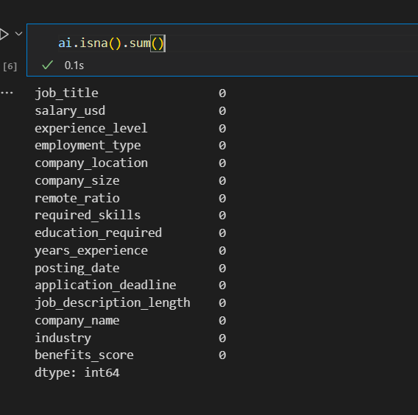
Missing Values Profile
Quantifying and locating null entries to understand patterns of missingness and justify our data cleaning strategy.
Critical Impact
Missing data can bias models and lead to invalid conclusions. A clear profile is essential for data integrity.
Total Missing Cells
0

Slide 6
PART 02
Data Cleaning

Slide 7
Null Replacement Strategy
Detailing our rules-based approach to preserve data integrity and avoid artificial variance inflation.
→
→
Median Imputation
Mode Imputation
Forward Fill
Used for numerical features like `Salary` to maintain the central tendency.
Applied to categorical features like `Department` with the most frequent value.
Used for time-series data to carry forward the last known observation.

Slide 8
Categorical Outlier Detection
Before: Raw Data
Scanning for rare categories and typos to reduce noise and improve encoding reliability. Standardization is key to a clean analysis.
Executive
Mid-Level
Sr. level
Director
Impact of Cleaning
After: Standardization
By consolidating 50+ unique job titles into 12 standardized roles, we significantly reduce dimensionality and improve model performance.
Director

Slide 9
PART 03
Feature Engineering

Slide 10
Encoding Categorical Variables
Mapping abbreviations to human-readable labels while preserving ordinal relationships for algorithmic compatibility.
Employment Type
Seniority Level
Education Tier
'FT' → 'Full-Time'
'EN' → 'Entry Level'
0 → 'Associate'
'PT' → 'Part-Time'
'MI' → 'Mid-Level'
1 → 'Bachelor'
'CT' → 'Contract'
'SE' → 'Senior Level'
2 → 'Master'
'FL' → 'Freelance'
'EX’ → Director Level'
3 → 'PhD'

Slide 11
Datetime Feature Expansion
Transformation Example
Converting raw strings into a rich datetime format unlocks powerful time-series analysis, enabling us to explore trends, seasonality, and cohort behaviors.
"2023-05-15"
Convert to Datetime
Transform strings into a proper datetime object for accurate temporal operations.
Year: 2023
Month: 5
Extract Year & Month
Create new columns to enable aggregation and analysis of time-based patterns.

Slide 12
PART 04
Quality Assurance

Slide 13

Export Clean Dataset
Documenting the final deliverable to ensure transparency, reproducibility, and ease of use for all downstream stakeholders.
File Format
Compressed CSV (.csv.gz) for efficiency.
Final Schema
Clean, encoded, and documented column names and data types.
Validation Checksum
Provided for data integrity verification (e.g., MD5 hash).

Slide 14
PART 05
Exploratory Insights

Slide 15
High Correlation Spotlight
Presenting the top correlated variable pairs to guide feature selection and identify potential multicollinearity.
Intuitive Relationship
Spurious Relationship
A strong positive correlation is expected between `Years of Experience` and `Salary`.
An unexpected correlation between `Skills` and `Salary` is likely an artifact of hiring practices over time.
Correlation Coefficient (r)
Correlation Coefficient (r²)
0.74
-0.0025
This analysis helps identify features that may need to be dropped or combined to improve model stability.

Slide 16
Next-Step Recommendations
Summarizing our achievements and charting the course for future analytical and modeling efforts.
Modeling Directions
Predict salaries, cluster jobs by seniority, or build a recommendation system for career paths.
Data Quality Achieved
We have a clean, validated, and feature-rich dataset ready for advanced analysis.
Future Data Enrichment
Integrate external data like industry growth rates, cost of living indices, or skill demand forecasts.

Slide 17
THANKS!
Garima Agrawal

